Slide 1
Canny Edge Detection
ESSE 4690 Lab 02
Course Director: Dr. Gunho Sohn
TA: Maryam Jameela
30th Sep 2021

Slide 2
Submission
Code with descriptions
Result images
Report (max 10-12 pages)
Implementation procedure (be simple)
Result (images with titles and descriptions)
Discussion (major part)
No code in Report
Submit Code, Report and Results in Separate folders and Zip them Together
Upload them via eClass: Due 08:00pm, 7th Oct, 2020
Hints: Read the Lab2 introduction in detail
or email TA via maryumja@yorku.ca if you have more questions

Slide 3
Objectives
Implementation of Canny edge detection algorithm
Understanding of Canny edge detection theory
Optimization: Parameter tuning

Slide 4
Why Edge Detection
Most of the shape information of an image is enclosed in edges.
To locate and extract the boundaries of objects within the image.
To spot the discontinuity of brightness.
To reduce the amount of information to be processed for image analysis.
To preserve essential structural properties of an image.

Slide 5
Training Procedure
Edge Localization
Image
Smoothing
Edge
Computation
Non-maximum
Suppression
Input
⬧ t_{l} t_{h}
Adjust
Parameters
Quality
Assessment
Edge
Linking
OK?
No
Yes
Output

Slide 6
Image Smoothing
Convolution operation over input image using gaussian kernel to produce the blurred feature map of low frequency. By blurring the image or smoothing we decrease the edge content.
Image = imread(image_path)
Image_ gray = rgb2gray(image)
Gaussian_filter = fspecial(‘gaussian’, kernel_size, sigma)
Image_smoothed = im_myfilter(image_gray, Gaussian_filter)

Slide 7


Edge Computation
Sobel is derivative kernel which calculates the edges vertically and horizontally.
-1 0 1
S_{x} = -2 0 2
-1 0 1
1 2 1
S_{y} = 0 0 0
−1 −2 −1
Sobel:
G_{x} = I S_{x}
G_{y} = I S_{y},
I is the image matrix
_{G} 2
E =
G
2
E = arctan(^{Gy} )
s
x
y
o
G
[0-360]
x

Slide 8
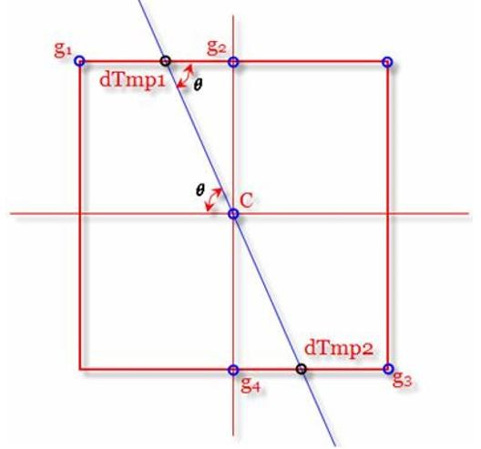
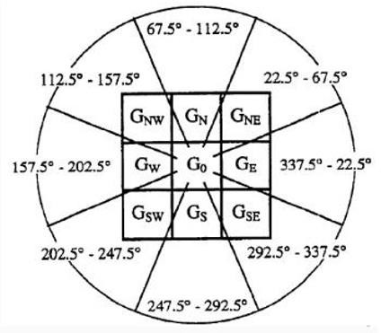
Non-Maximum Suppression
Non-maximum suppression is refinement of edges. It keeps information with high confidence and suppress the edges with low confidence.
local maximum others
g = ^{⎧g}
⎨₀
⎩
Comparison along
The edge orientation
Suppression: retain the
Local maximum
Decode the Edge
Orientation
Interpolation Value:
dTmp1, dTmp2
Neighboring Pixel Value:
g2, g4

Slide 9
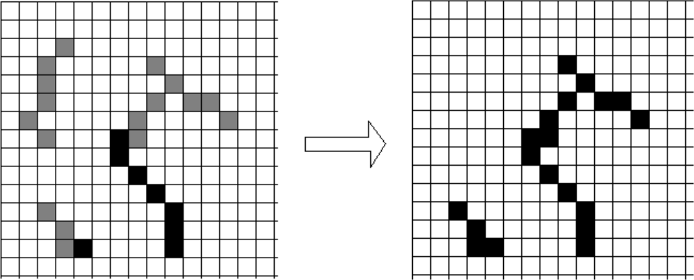
Edge Linking/ Edge Extension
Edge linking is the process of tracking the edge points and linking them to form an edge or boundary of an object in the image.
Double Thresholding
(t_{l} t_{h} )
g ≥ t_{h} strong edge=1
⎧
⎪
⎨t_{l} ≤ g < t_{h} weak edge=0.5
⎪
g < t non edge=0
⎩
l

Slide 10
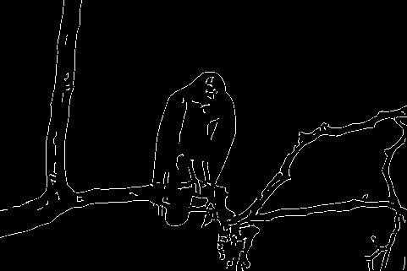
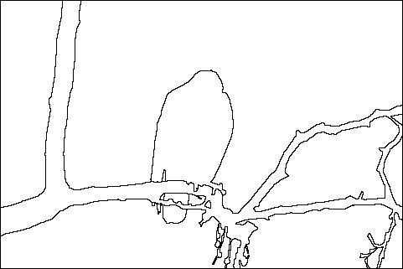
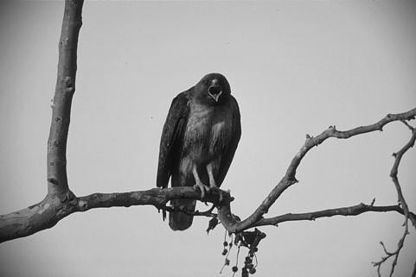
Quality Assessment
 |  | Your Detection
 |  | T | F
Ground Truth | T | True Positive | False Negative
 | F | False Positive | True Negative
Confusion Matrix
TPR = TP / (TP + FN ) ⇒ correctly detected edge
FPR = FP / (FP + TN ) ⇒ incorrectly detected edge
Accuracy = (TP + TN ) / (TP + TN +FP+FN)

Slide 11
Edge Detection Functions
Input Image: transfer image to gray format and pixel intensities to [0,1] range.
Gradient Computation: output gradient magnitude and direction at each pixel position.
Non-Maximum Suppression: output single-pixel-width edge image.
Double Thresholding: output pixel intensities should be 0, 0.5 or 1.
Edge Linking: output the final edge detection result.
Quality Assessment: output TPR, FPR.

Slide 12
Optimization
Parameters: (σ , t_{h} , t_{l} )
Typically set t_{h} = 2, t_{l}= 0.02
Initialize the parameter value. For example, σ= 0.5, t_{l}
Run the whole edge detection procedure on training images
Increase the parameter and repeat the procedure utill the best TPR, FPR or Accuracy is obtained
Test the optimized parameter set on the test image

Slide 13
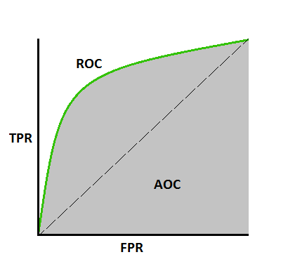
ROC Curve
Change Parameters and Plot TPR and FPR

Slide 14
Discussion
Analysis of your detection results
Show some intermediate results
Describe and discuss about the optimization part
Any detailed or small step that makes a difference the detection performance (interpolation, edge linking, etc.)

Slide 15
Marks Breakdown
+50 pts: Working implementation of Canny edge detector +30 pts: Working implementation of quality assessment and parameter optimization +20 pts: Writeup with several examples of hybrid images +10 pts: Extra credit (up to ten points) -5*n pts: Lose 5 points for every time you do not follow the instructions for the hand in format -5*n pts: Lose 5 points for every day you delay the submission of your report and codes beyond the due date.

Slide 16
Data & Codes
Log onto eClass (https://eclass.yorku.ca/)
Choose the course 4690
Click into Canny Edge Detection and find the lab part

Slide 17
Questions
Read the Lab2 introduction in detail
Email TA via maryumja@yorku.ca

